Slide 1
IBM HACK CHALLENGE - 2020
KARPAGAM COLLEGE OF ENGINEERING
SENTIMENT ANALYSIS OF COVID-19 TWEETS - VISUALIZATION DASHBOARD
CODE BLASTERS
SHAIRAM R
VEERAKUMAR N
SHASTI AYAPPAN R

Slide 2
OUTLINE
Abstract
Problem description
possible solution
Block diagram
Software components used
Result
Advantage and disadvantages
Future scope

Slide 3
ABSTRACT
PROBLEM STATEMENT :
Coronavirus made 2020 unforgettable.
Economically many of them are affected, from small companies to large companies.
Lockdown affects people’s mind because of being in home for long time.
We are in need to analyse sentiment of the people in order to extend the lockdown and for making further decisions.

Slide 4
ABSTRACT CONT.
POSSIBLE SOLUTION :
Analysing the tweets to know the sentiment of the people.
Visualize the analysed data using map to locate where sentiments of people are getting low.
Visualized data could be used by the government to monitor and analyse:
people’s mindset and
sentimental behaviour in this lockdown.

Slide 5
BLOCK DIAGRAM
Twitter API
Back-End
Front-End
Pre-Processing data
Data from Back-End
MAP
Location Fetching
Analysing Data
wordcloud
Other infos
Get coordinates
Wrapping up infos as json

Slide 6
SOFTWARE COMPONENTS USED
BACK-END :
Language used :
Python
FrameWork :
Django
API used :
Twitter
Modules used :
Tweepy
Tweet-preprocessor
Textblob
pandas

Slide 7
SOFTWARE COMPONENTS USED cont.
FRONT-END
Language used :
HTML (Markup language), CSS (Style sheet), JavaScript
API used :
ArcGIS
Plugin used :
3D interactive SVG tag cloud

Slide 8
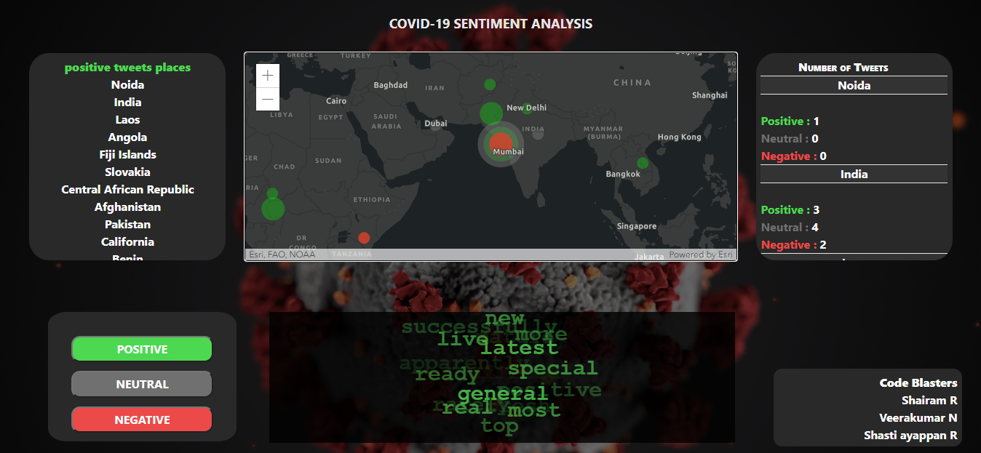
RESULT

Slide 9
MERITS AND DEMERITS
Merits :
This application fetches real-time tweets dynamically and analyses them to visualize.
using this we could find the location of the people with sentimental polarity positive, negative and neutral.
Demerits :
We weren't able to use Geocoder APIs which will provide the accurate coordinates.
It just fetches and analyses the recent 100 tweets and visualizes them because of limited API calls.
Sometimes the location given by the user in a tweet may be wrong.

Slide 10
FUTURE SCOPE
Paid geocoders can be used to enhance the accuracy of the coordinates if sponsored.
Integrating this application with twitter could fetch the correct location of the user.
Could improve the analysis by using high-end and more accurate models.
Could improve the visualization UI to make more it user friendly.

Slide 11
THANK YOU

